Slide 1
ReverseMe Hack

Slide 2
Overview
What the ReverseMe challenge is
Learning a quick overview of Machine Language and Assembly Language
A pointer to where to start

Slide 3
What is the Challenge?
A hacker has infiltrated a companies code! (probably shouldn’t have left that back door open). You need to find the encrypted message to stop the attack on their system before it can do any more damage.
Decipher the clues in the code and write out the message!

Slide 4
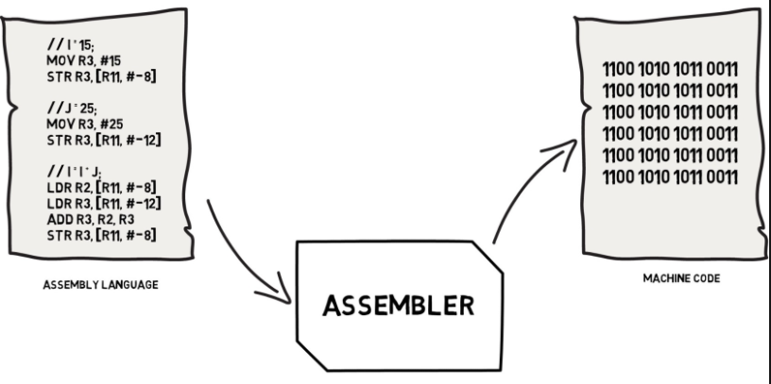
What is Assembly language?
The lower level language code that is converted by an assembler into binary.
This is what high level languages like C# and C++ are converted into before being converted to binary for the computer to understand.

Slide 5
Basic Functions
LEA – Load Effective Address | The lea instruction places the address specified by its second operand into the register specified by its first operand.
MOV - Move | The mov instruction copies the data item referred to by its second operand (i.e. register contents, memory contents, or a constant value) into the location referred to by its first operand (i.e. a register or memory).
RDX /EDX | Redirection to the address of a method
AND, OR, XOR -Bitwise logical and, or and exclusive or | These instructions perform the specified logical operation (logical bitwise and, or, and exclusive or, respectively) on their operands, placing the result in the first operand location.
JMP - Jump | Transfers program control flow to the instruction at the memory location indicated by the operand.

Slide 6
What you need to download
Everything in here:
https:https://github.com/Drags249/ReverseMeBits.git//github.com/Drags2
This should be:
The executable file
Debuger (x64dbg)
This presentation

Slide 7
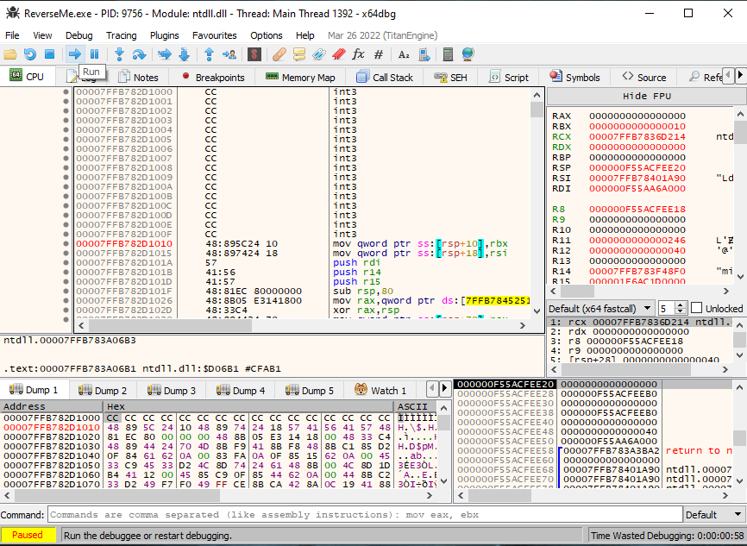
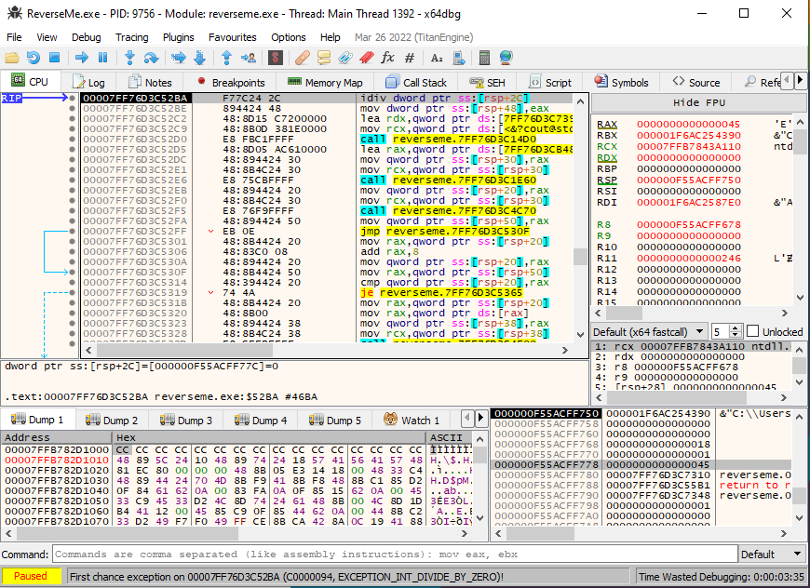
Where to Begin?
Click here to run
Get x64dbg open in 64-bit mode
Open the reverse-me.exe
Run it until it hits an exception (status at bottom left, run button is the right arrow at the top) -- exception is DIVIDE_BY_ZERO
Scroll up a bit and look for RtlAddVectoredExceptionHandler (https://docs.microsoft.com/en-us/windows/win32/api/errhandlingapi/nf-errhandlingapi-addvectoredexceptionhandler)
Exception can be found here

Slide 8
PRIZES!
Prizes will be awarded to the person
That identifies the message first
Prints the message in the console first
Knows Assembly Language already (even the basics). Knowledge is power!

Slide 9
Questions & answers
Invite questions from the audience.

Slide 10
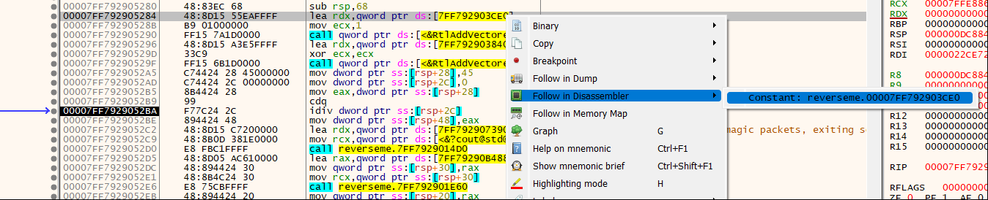
Clue 1

Slide 11
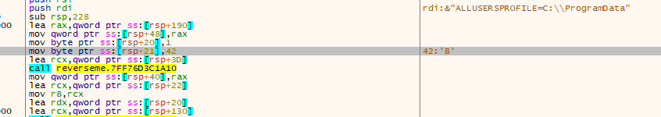
Clue 2
Where have I seen ‘B’ and 42 together before?.....

Slide 12
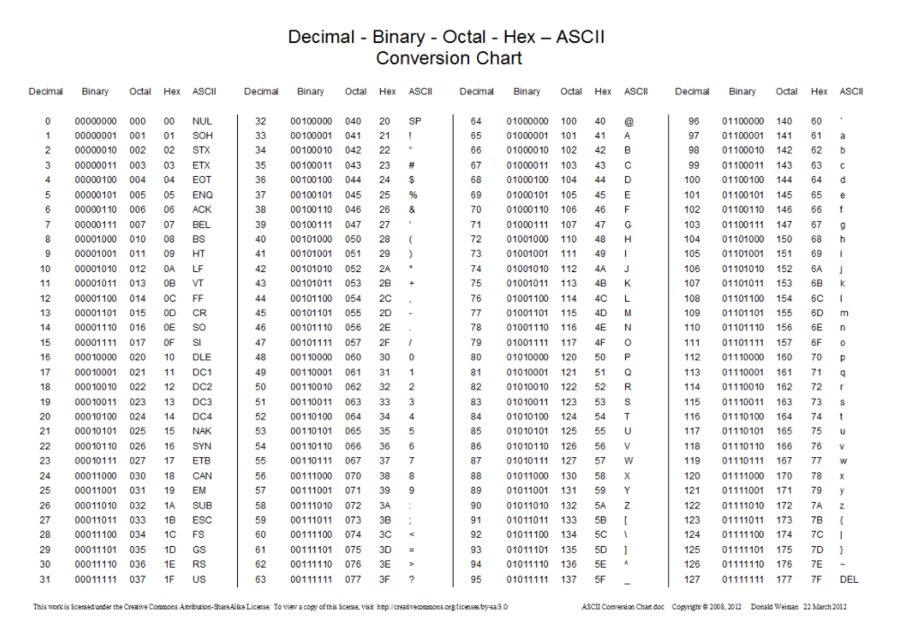
Clue 3

